Slide 1


Lesson 3: Wayback Machine
Alternative to website access
csinschools.com

Slide 2

Internet Archive: Wayback Machine
The Internet Archive Wayback Machine was created in 1996. From 2001, Internet users could access the site and ‘travel back in time’ to view previous versions of a website.
Some schools have trouble accessing web.archive.org, so this slide deck allows students to complete the activity by referring to the slides instead.

Slide 3
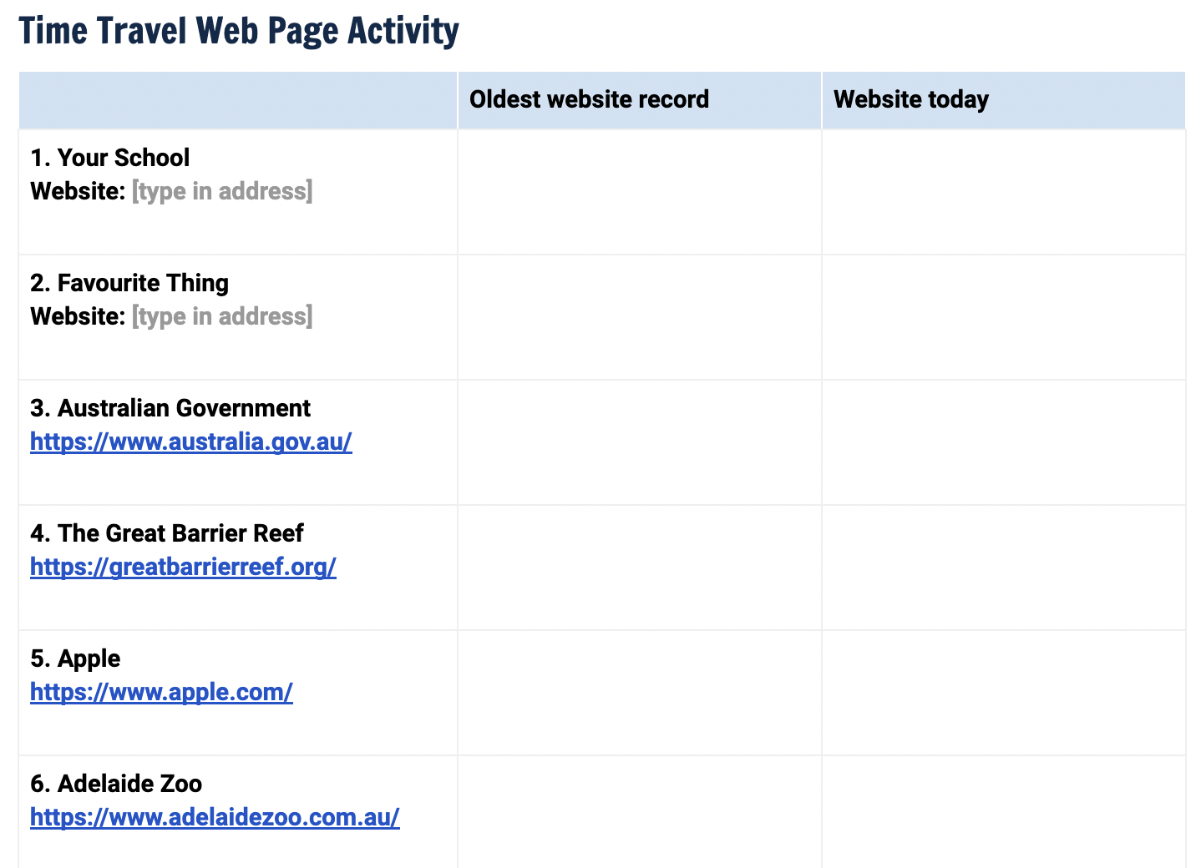


Instructions
Access Time Travel Web Page Activity Sheet
Make a copy (save it to your preferred location)
Copy each of the following webpage images (slides 4-11) into your worksheet
Access the current website for each.
Screenshot and paste into the “Website today” column
Compare the old websites with the new ones
Discuss your findings with the class
How to take a screenshot

Slide 4
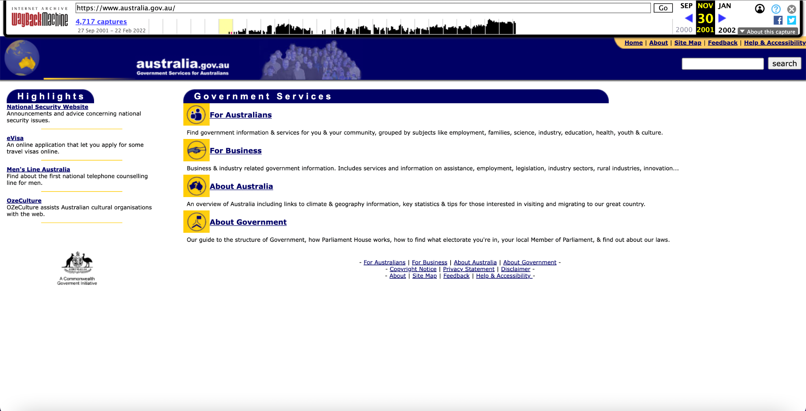
The Australian Government

Slide 5
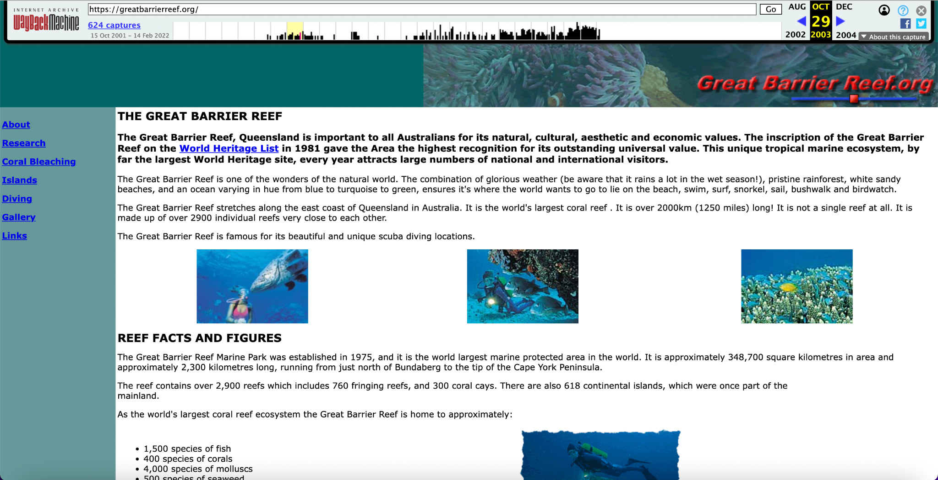
The Great Barrier Reef

Slide 6
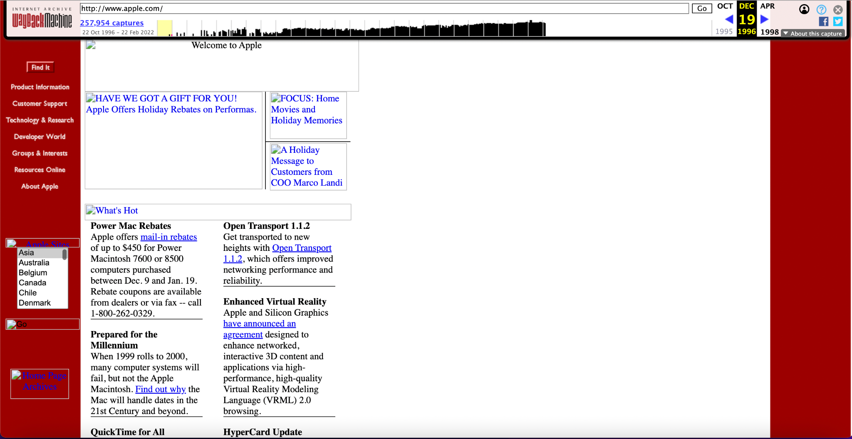
Apple

Slide 7
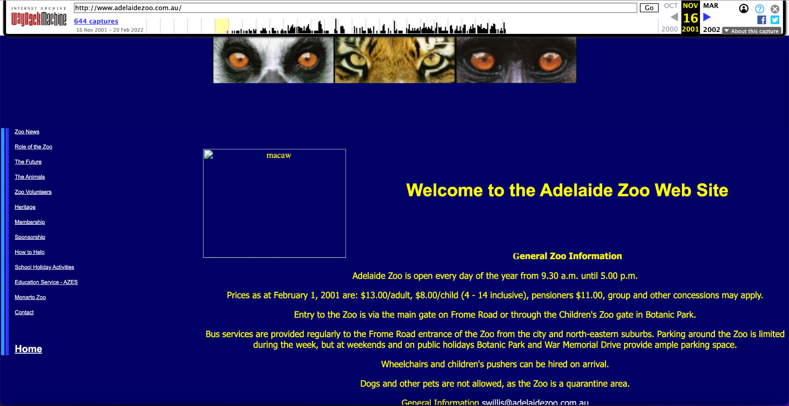
The Adelaide Zoo

Slide 8
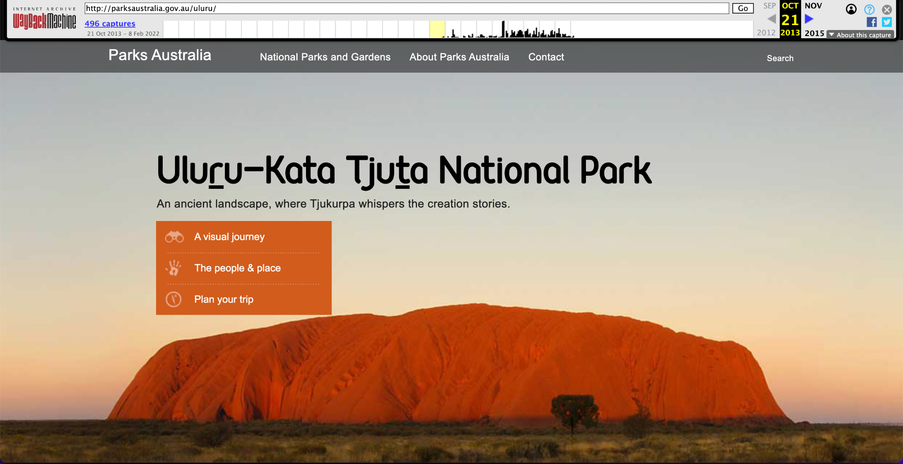
Uluru

Slide 9
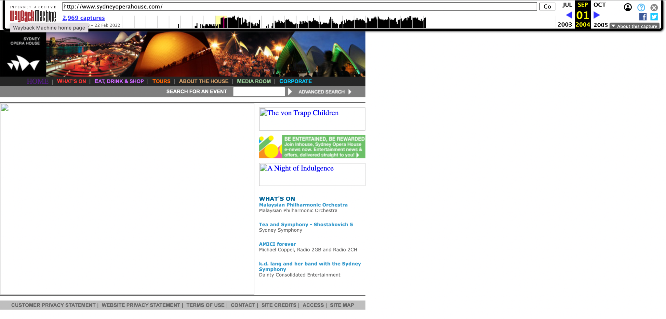
Sydney Opera House

Slide 10
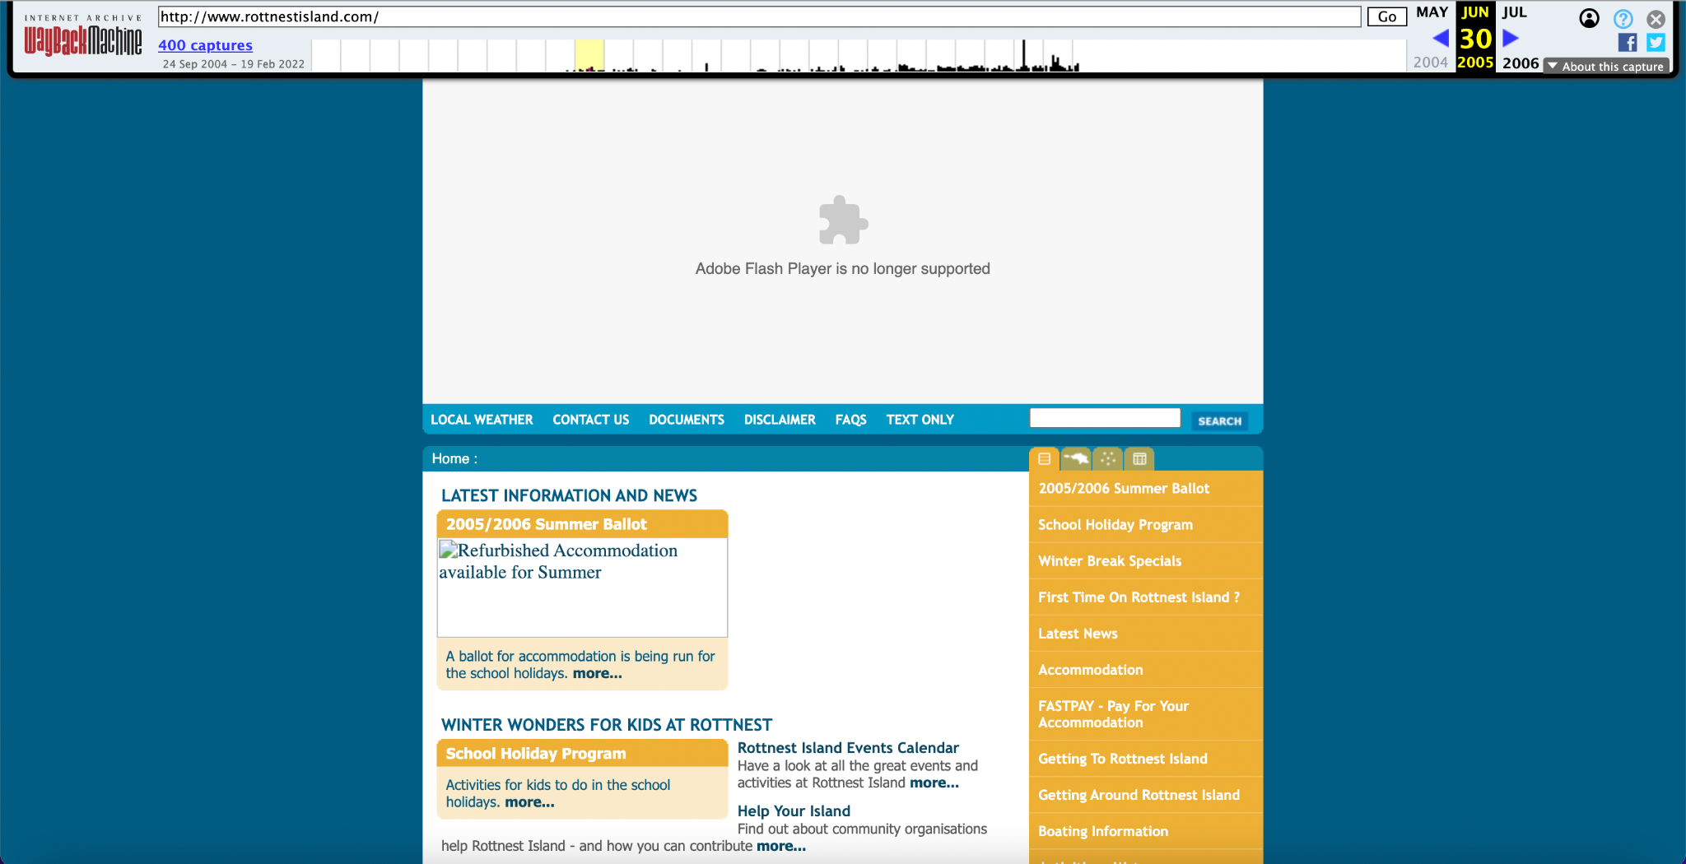
Rottnest Island

Slide 11
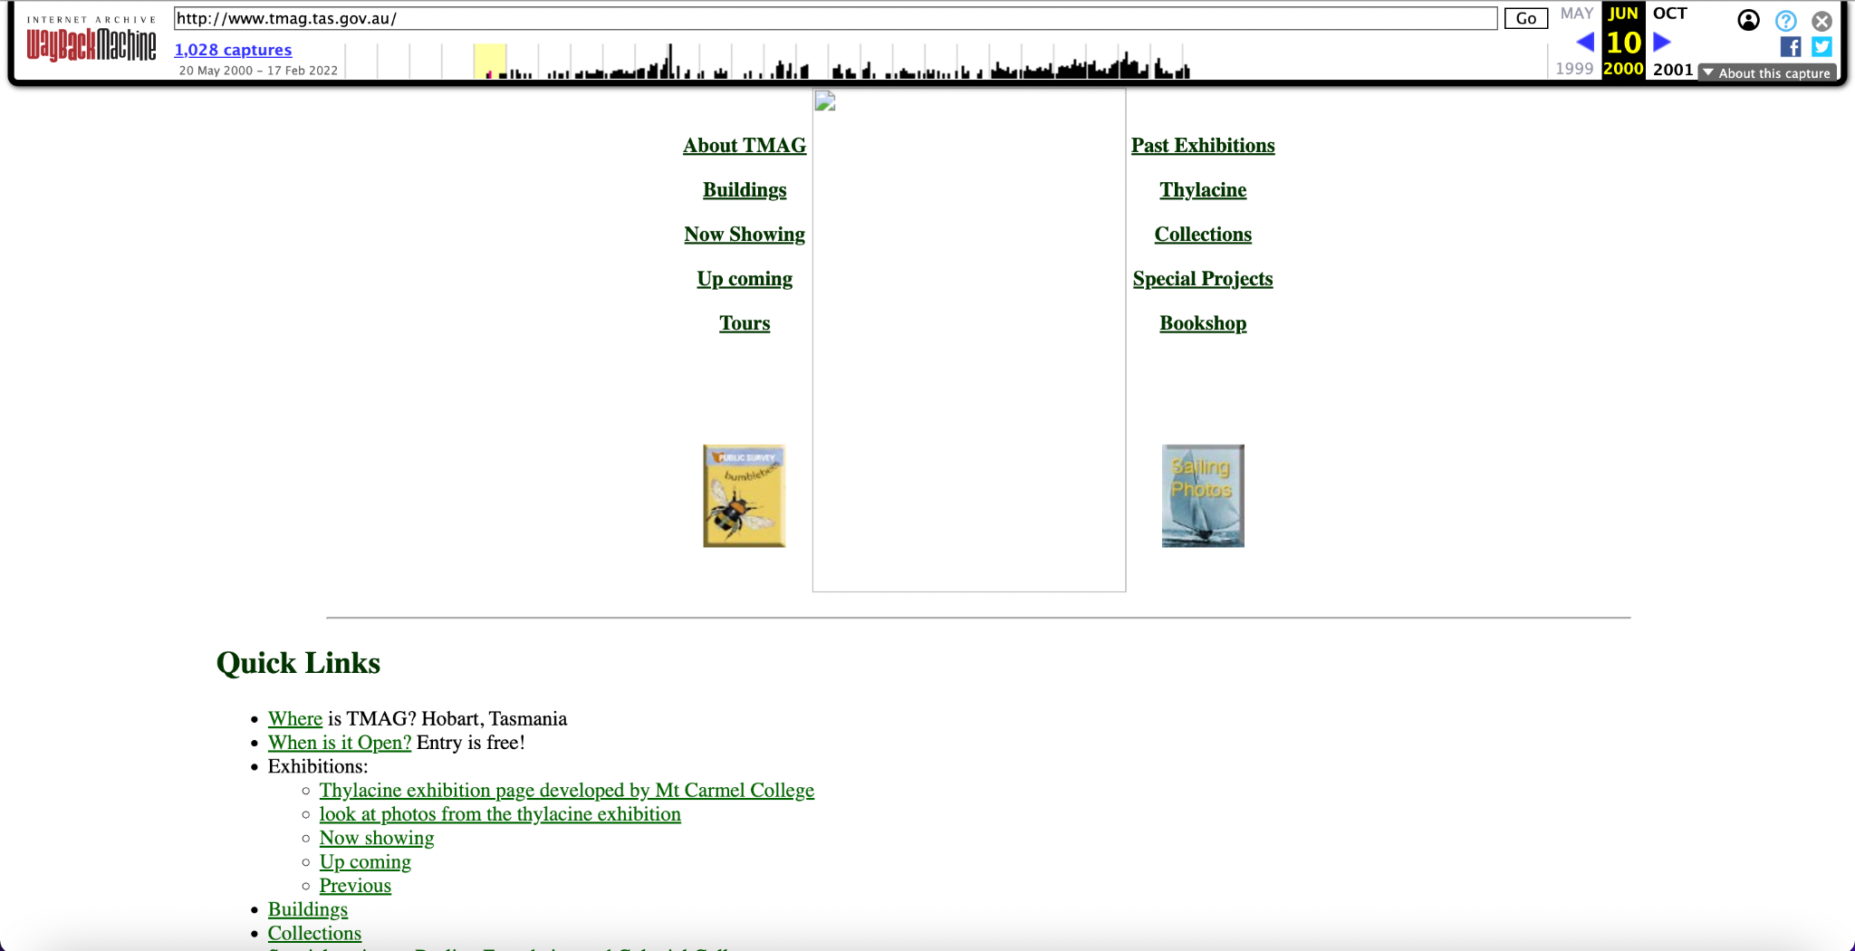
Tasmanian Museum and Art Gallery

